Slide 1
Using ChatGPT to develop ShinyApps for visualizing the concentration of amoebas.
Elizabeth Ortiz
4/25/24

Slide 2
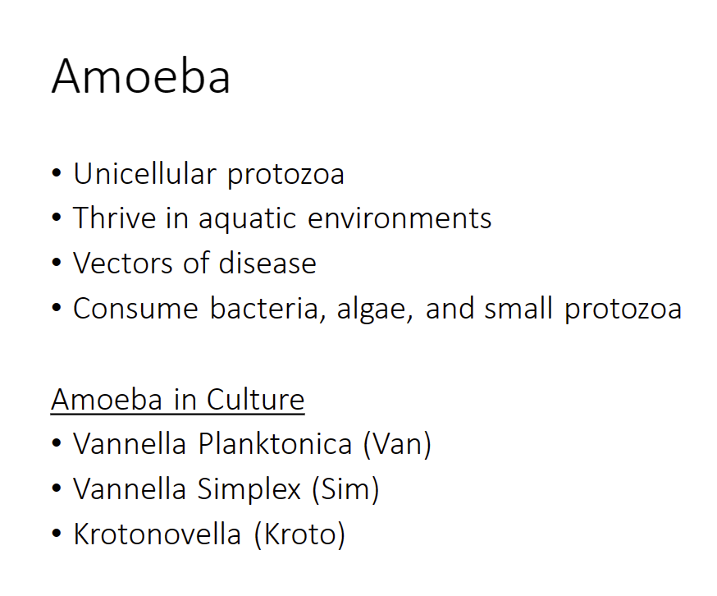

Slide 3
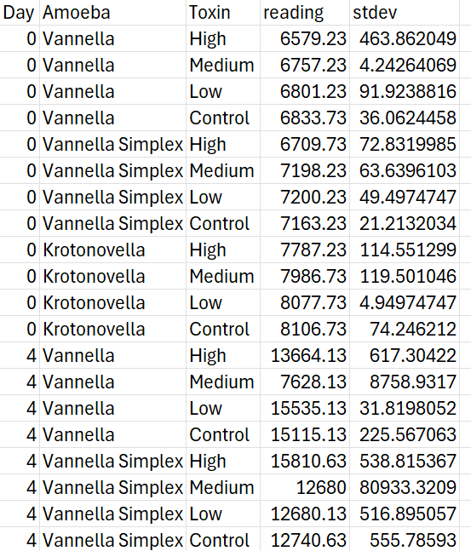
Research Questions
Does microcystin toxic exposure affect amoeba concentration levels?
Can we develop a tool to visualize amoeba population growth rates?

Slide 4
Objective
Obtain a functional ShinyApp that will display amoeba concentrations.

Slide 5
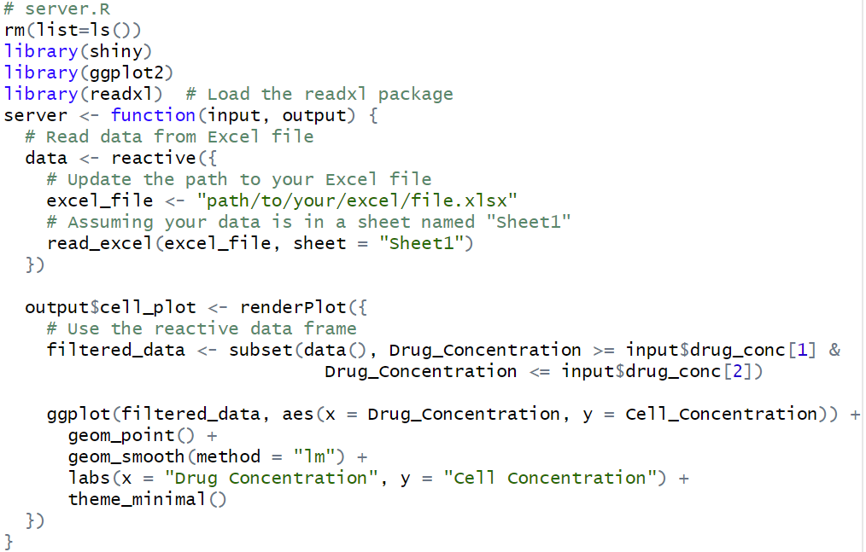
Error: object 'ui' not found

Slide 6
Error: object 'ui' not found
ChatGPT Says
Incorrect Script Execution
Script Location
Syntax Errors
R Session
File Name

Slide 7
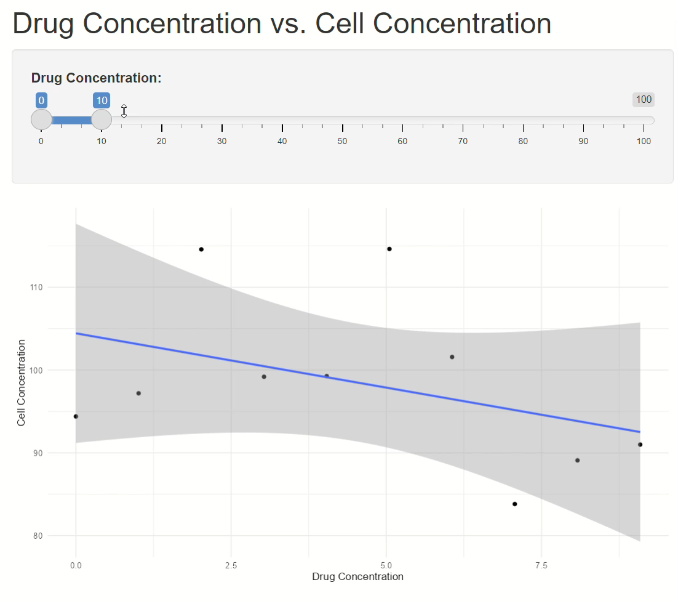

Slide 8
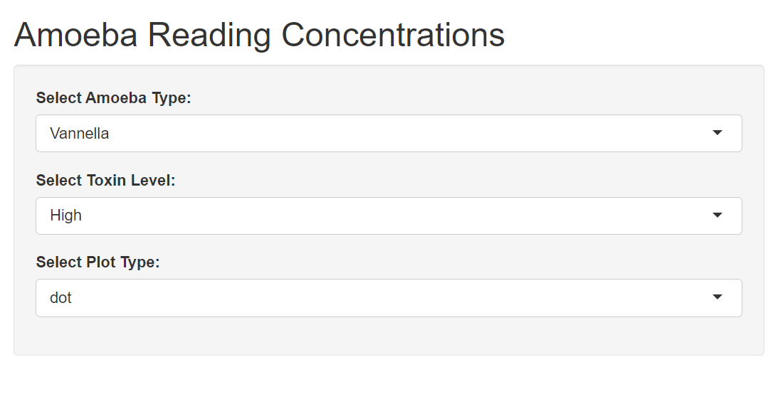

Slide 9
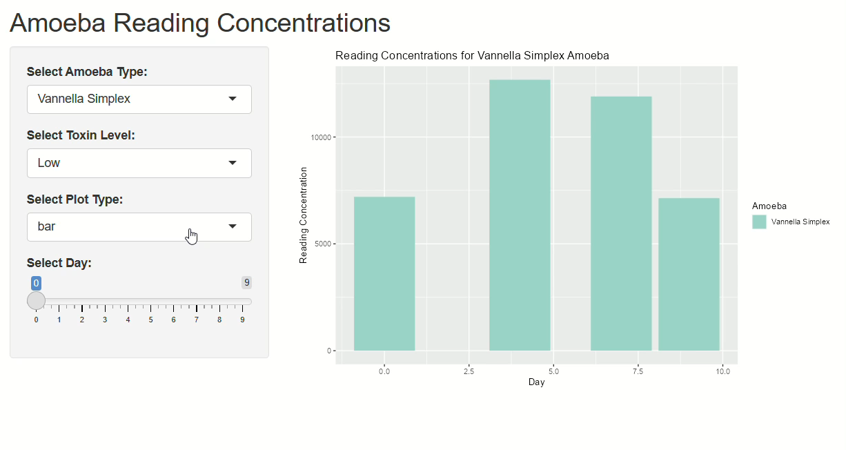

Slide 10
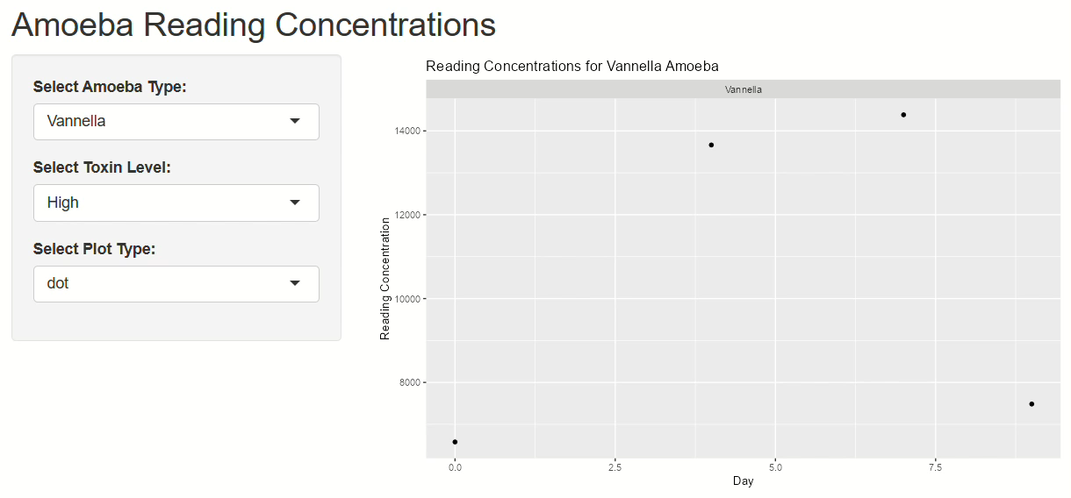

Slide 11
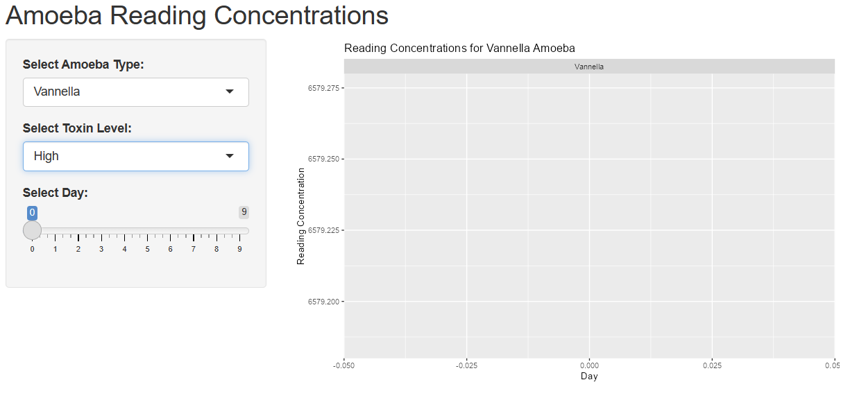

Slide 12
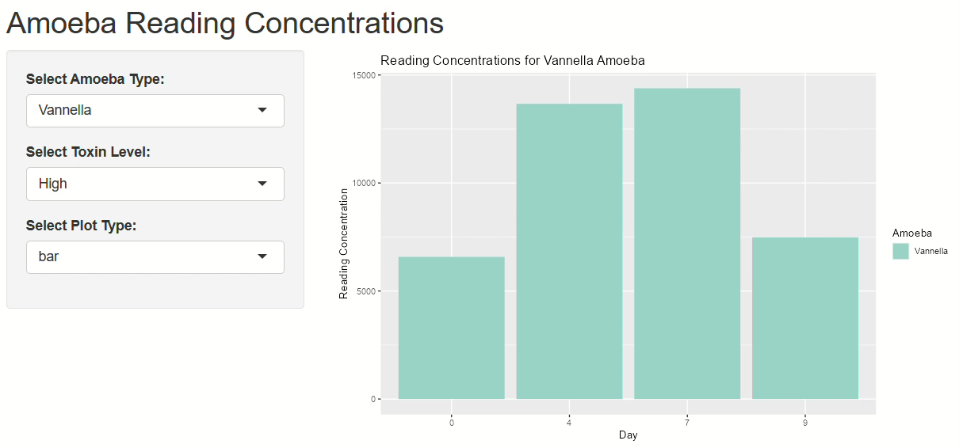

Slide 13
What did I learn?
Trial 1
I have data showing that varying drug concentrations will affect the cell concentration. How can i create a shinyapp through rstudio to demonstrate the interaction and effect of drug concentration to cell concentration?
Trial 2
I have data in a .csv file format. This data columns for Day, Amoeba, Toxin, reading, stdev. The "Day" column has days "0", "4", "7", and "9". The "Toxin" column has concentration in the category of "High", "Medium", and "Low". The "Amoeba" column has the organism names of "Vannella", "Vannella Simplex" , and "Krotonovella". The "reading" column shows the varying concentration of the Amoeba organism. The "stdev" column shows the standard deviation for the results of the "reading" column. I want to create a shinyapp using rstudio to show how the "reading" concentrations for each "Amoeba" type changes in response to "Toxin" over "Day". Can you help me with this, please?

Slide 14
Thank you

